Slide 1


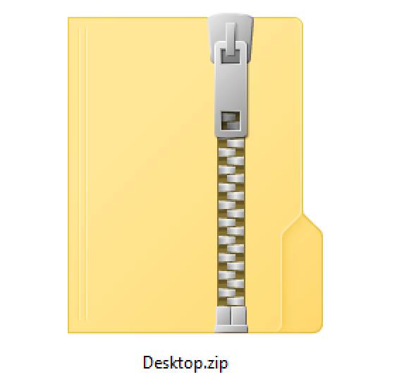









Your floorplans
in DWG format
Packaged ZIP file
Web SDK
Upload and store
Drawing package
Convert
Drawing package
Azure Maps
Services
Mobile SDK
Create indoor
map data
Tilesets
Datasets
Feature
statesets

